Slide 1
17 United Nations Sustainable Development Goals
David M. Boje
Use these for your group projects

Slide 2
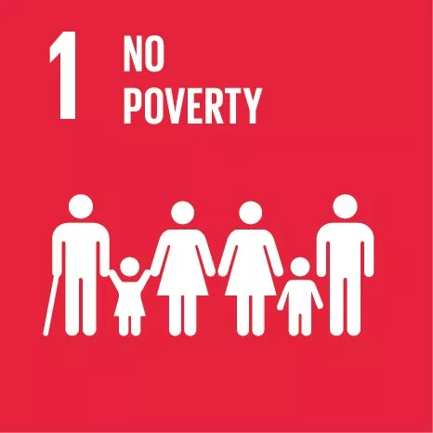
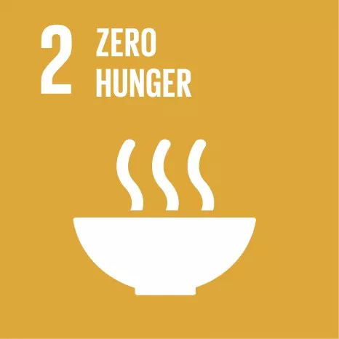

Slide 5
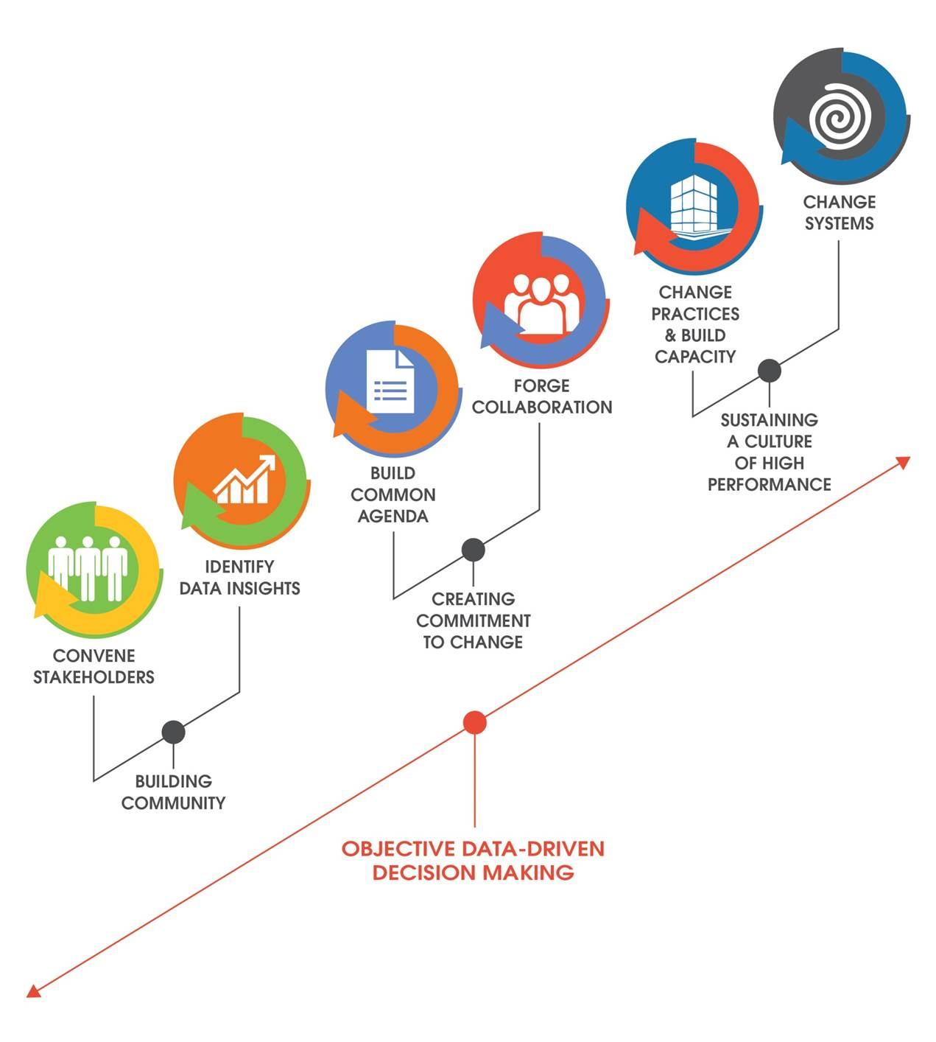
Antenarrative Process of Transformation
Notes:
http://e3alliance.org/wp-content/uploads/2015/06/TOC-no-logo1.jpg

Slide 6
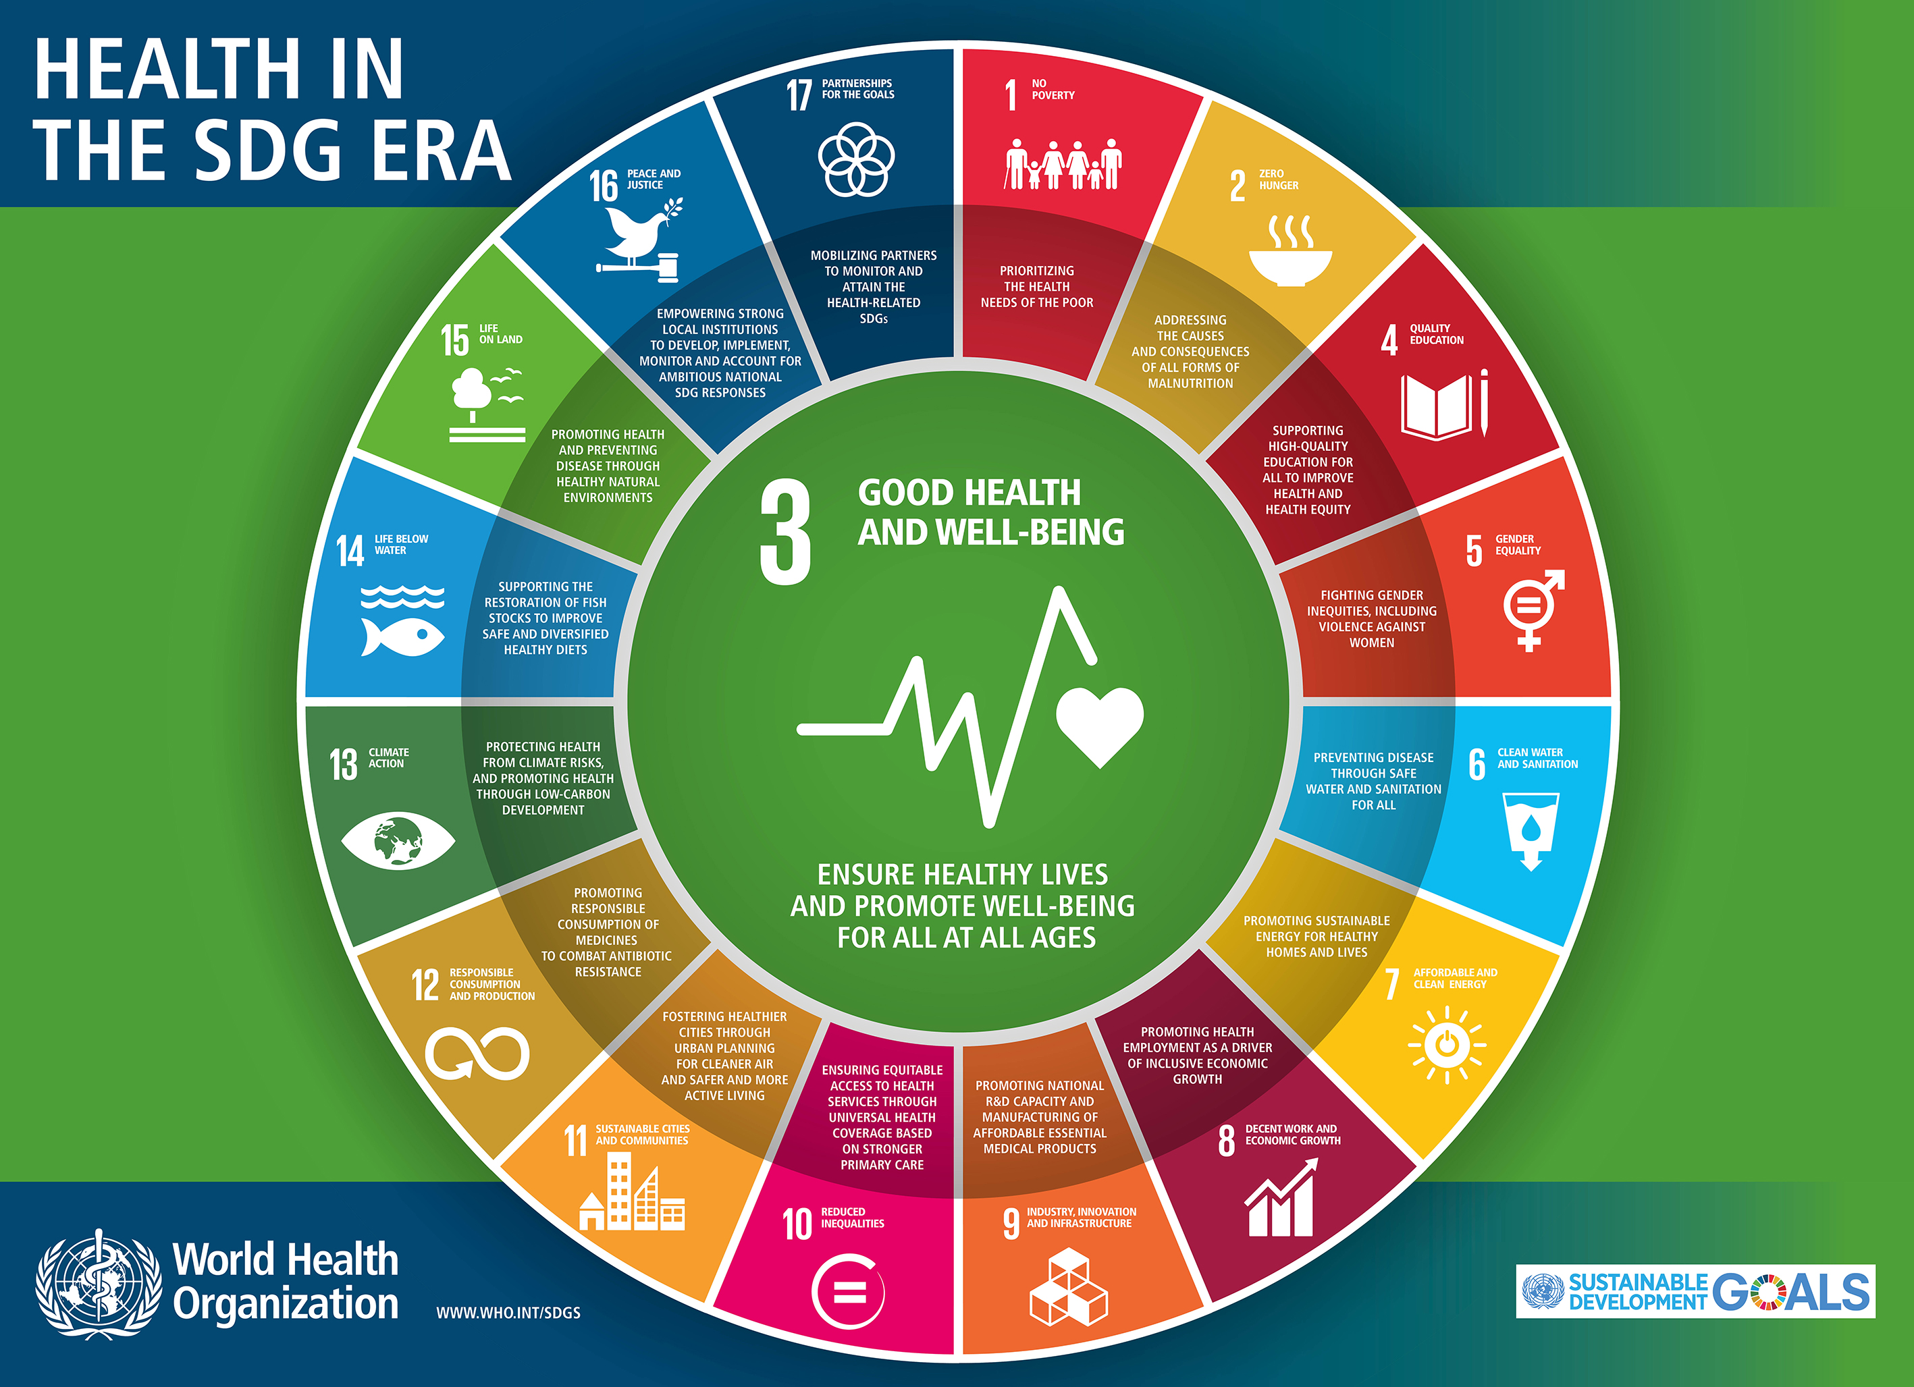
You can Refract your Goal into the other Goals e.g. #3

Slide 7
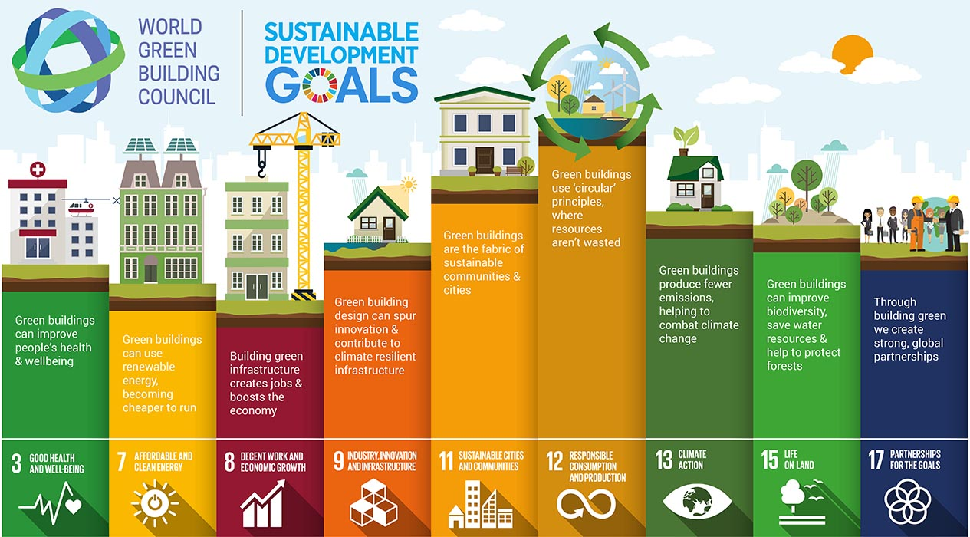
Another Refraction Example

Slide 8
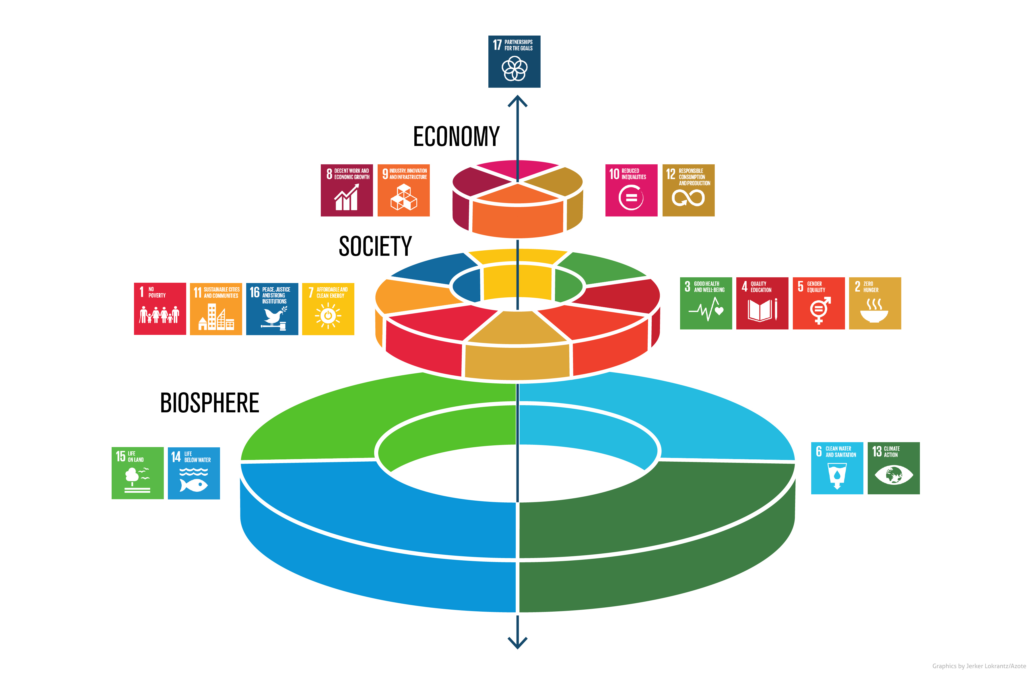
Sort the Goals …
Notes:
http://www.stockholmresilience.org/images/18.36c25848153d54bdba33ec9b/1465905797608/sdgs-food-azote.jpg

Slide 9
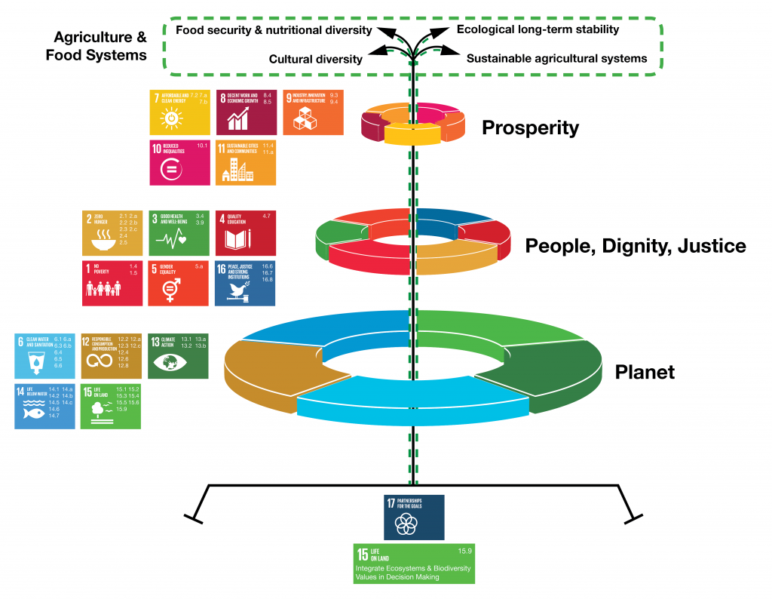

Slide 10
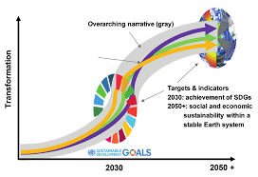
Direction of Ante-Narrative futures (blue, green, orange)
Notes:
https://encrypted-tbn0.gstatic.com/images?q=tbn:ANd9GcQJOpJnpfTFRIoAlTvjQWiIjDsI2yn6E4y86CNLcPujZXVyT4TBkg

